Slide 1

PromptMobile: Efficient Promptus for Low Bandwidth Mobile Video Streaming
Liming Liu, Jiangkai Wu, Haoyang Wang, Peiheng Wang, Zongming Guo, Xinggong Zhang†

Slide 2






Background
Top Content Categories by
Downstream Volume (Mobile)
Bandwidth

Slide 3

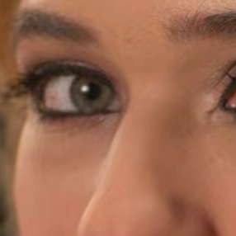
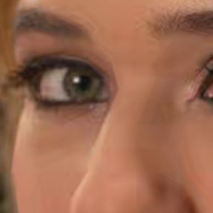
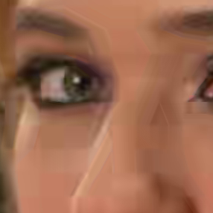
Background
Bandwidth
GT
1200 kbps
600 kbps
200 kbps
Top Content Categories by
Downstream Volume (Mobile)

Slide 4
Background
Bandwidth
GT
1200 kbps
600 kbps
Blur
Blocking Artifacts
200 kbps

Slide 5






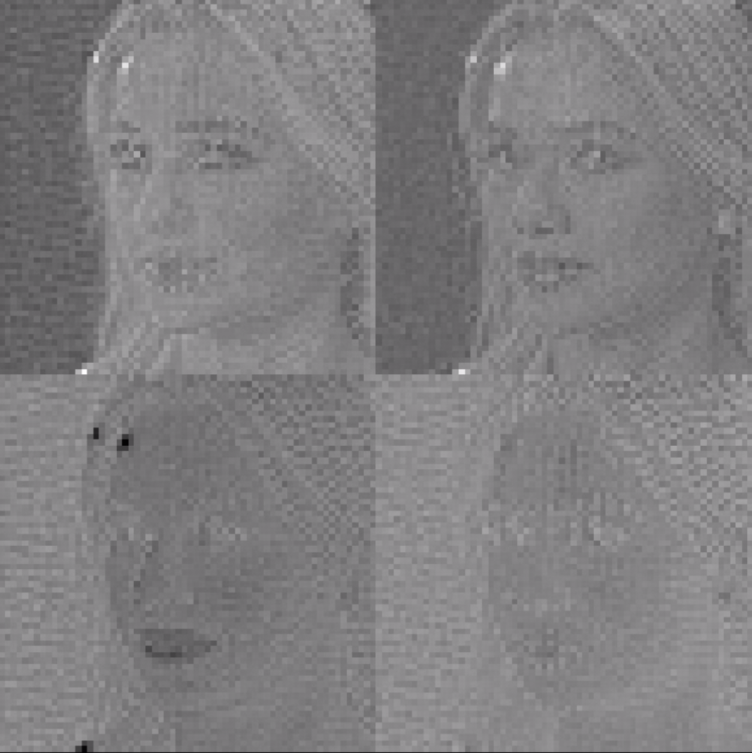
Background
Prompt
Stable Diffusion Pipeline
Prompt Inversion
1024
Sentence
Embedding
77
Loss
2.52 Mb
Update
Low Rank Decomposition
Noise
Latent
U-Net
Decoder
Image
GT

Slide 6
Background
Prompt
Stable Diffusion Pipeline
140 Kb
4
Prompt Inversion
1024
Sentence
Embedding
77
Loss
2.52 Mb
Update
Low Rank Decomposition
Noise
Latent
U-Net
Decoder
Image
GT

Slide 7
Background
Prompt
Stable Diffusion Pipeline
140 Kb
4
Prompt Inversion
Update
Sentence
Embedding
Loss
Embedding Interpolation
Low Rank Decomposition
Noise
Latent
U-Net
Decoder
Image
GT
1024
77
2.52 Mb

Slide 8
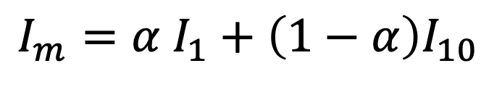
Background
Stable Diffusion Pipeline
Prompt Inversion
Update
Loss
Sentence
Embedding
Embedding Interpolation
Frame 1 (I1)
Frame 10 (I10)
…
…
Frame 2 (I2)
Frame 5 (I5)
Frame 9 (I9)
Low Rank Decomposition
$$I_{m}=α I_{1}+\left(1−α\right)I_{10}$$
Noise
Latent
U-Net
Decoder
Image
GT

Slide 9
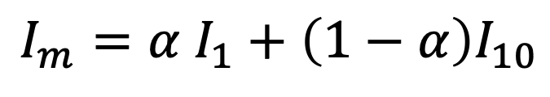
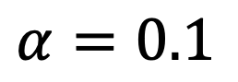
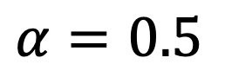
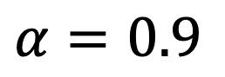
Background
Sentence
Embedding
Frame 1 (I1)
Frame 10 (I10)
Embedding Interpolation
$$α=0.9$$
…
$$α=0.5$$
…
$$α=0.1$$
Frame 2 (I2)
Frame 5 (I5)
Frame 9 (I9)
$$I_{m}=α I_{1}+\left(1−α\right)I_{10}$$
Only 3.1 Frames / Second

Slide 10
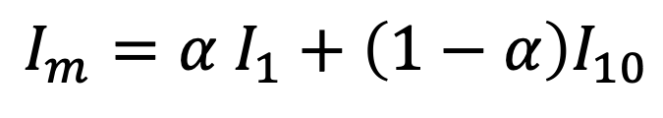
Background
Sentence
Embedding
Frame 1 (I1)
Frame 10 (I10)
Embedding Interpolation
$$α=0.9$$
…
$$α=0.5$$
…
$$α=0.1$$
Frame 2 (I2)
Frame 5 (I5)
Frame 9 (I9)
$$I_{m}=α I_{1}+\left(1−α\right)I_{10}$$
Only 3.1 Frames / Second
512 x 512 @ 30 Frames / Second

Slide 11
Observation & Motivation
1.00x
2.32x
8.67x

Slide 12
Observation & Motivation
Sentence
Embedding
Light-weight Upscaling
Noise
Latent
U-Net
Decoder
Low-res
Image
Full-res Image

Slide 13
Observation & Motivation
Sentence
Embedding
Light-weight Upscaling
Noise
Latent
U-Net
Decoder
Low-res
Image
Full-res Image

Slide 14
Observation & Motivation
Sentence
Embedding
X
dX
Y
Layer Norm
Cross Attention
+
X
dX
+
Y
Layer Norm
Self Attention
X
dX
+
Y
Light-weight Upscaling
Layer Norm
Feed Forward
Noise
X
Latent
dX
+
Y
Decoder
Low-res
Image
Res Block Layer
Full-res Image
U-Net

Slide 15
Observation & Motivation
Sentence
Embedding
Overview
Cache
Sentence
Embedding
X
dX
Y
Layer Norm
Cross Attention
+
X
dX
+
Y
Layer Norm
Self Attention
X
dX
+
Y
Light-weight Upscaling
Layer Norm
Feed Forward
Noise
X
Latent
dX
+
Y
Decoder
Low-res
Image
Res Block Layer
Full-res Image
U-Net

Slide 16
Overview
Observation & Motivation
Sentence
Embedding
Two-stage Efficient Generation
Fine-grained Inter-frame Caching
Cache
Light-weight Upscaling
Noise
Latent
U-Net
Decoder
Low-res
Image
Full-res Image

Slide 17







Method - Two-stage Efficient Generation
Observation & Motivation
128x128
256x256
368x368
512x512
512x512
256x256
128x128

Slide 18
Method - Two-stage Efficient Generation
Observation & Motivation
512x512
368x368
256x256
128x128
512x512
256x256
128x128

Slide 19
Method - Two-stage Efficient Generation
Stable Diffusion
Light-weight Upscaling
Decoder
Low-res
Image
Full-res Image
Unstitch Module

Slide 20
Method - Two-stage Efficient Generation
Stable Diffusion
Unstitch Module
Light-weight Upscaling
Decoder
Stitched
Image
Low-res
Image
Full-res Image

Slide 21
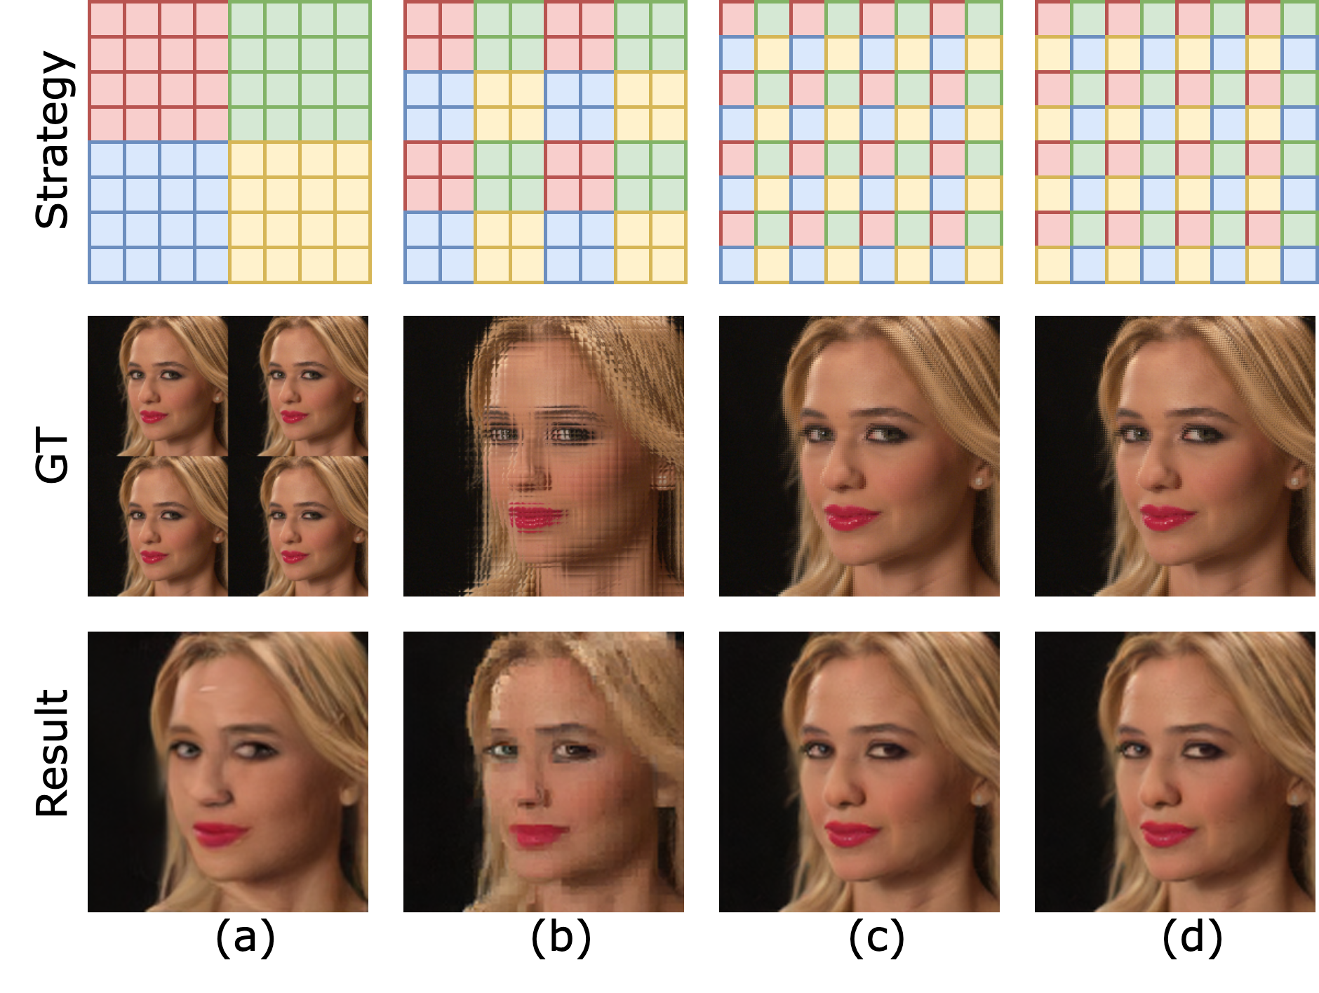
Method - Two-stage Efficient Generation

Slide 22
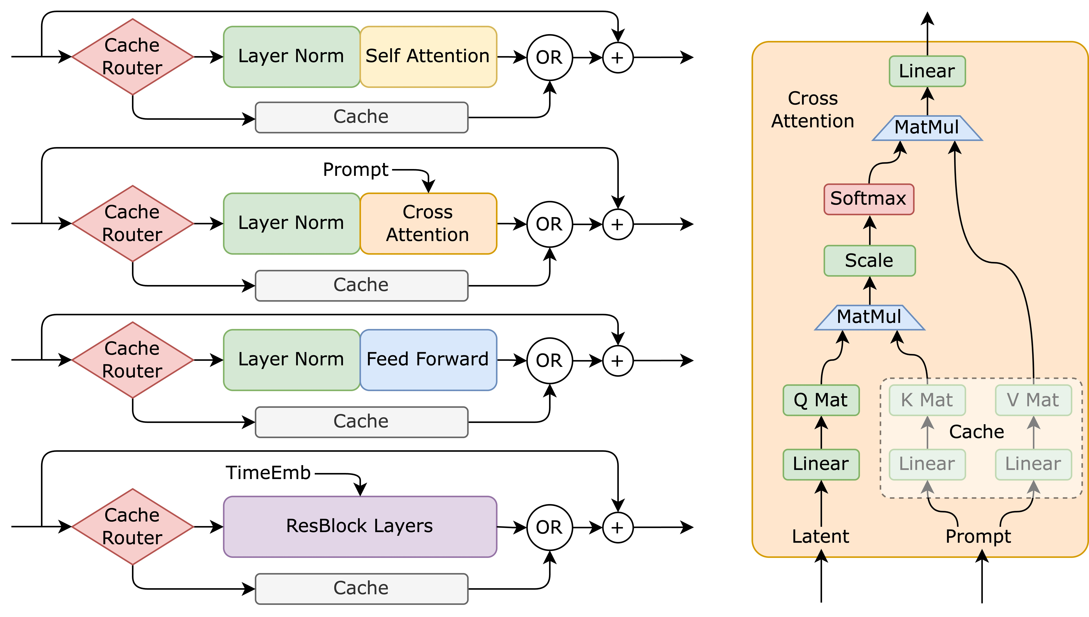
Method - Fine-grained Inter-frame Caching

Slide 23
Method - Fine-grained Inter-frame Caching

Slide 24
Evaluations – Cache Trade-off

Slide 25
Evaluations – Quality

Slide 26
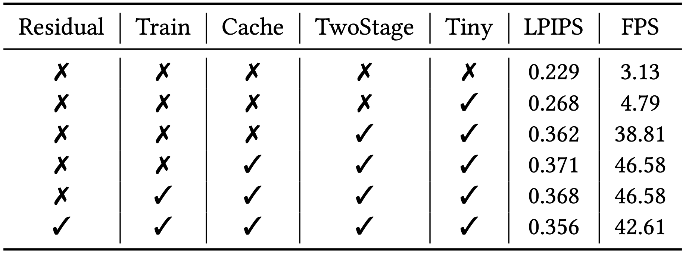
Evaluations – Ablation

Slide 27

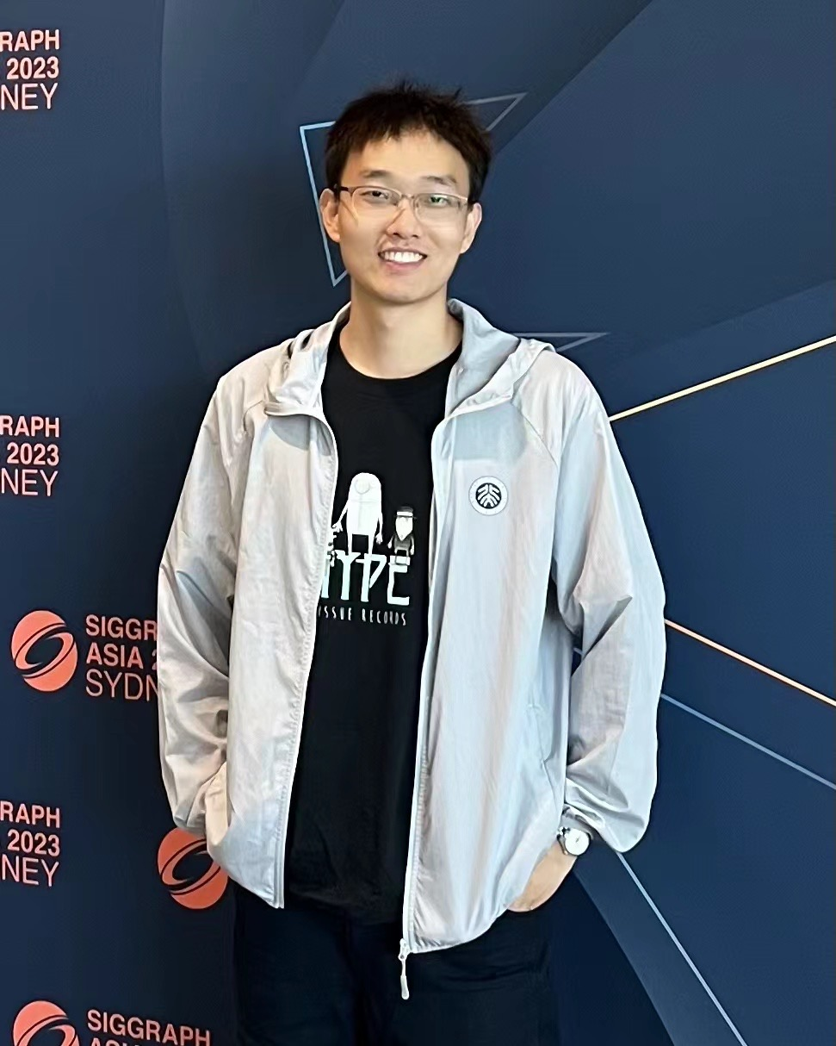
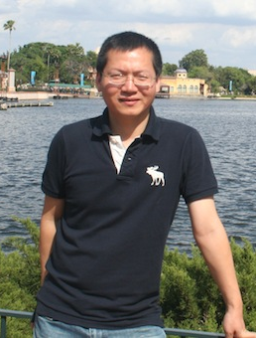
Thanks for Listening
Code repo:
Research Papers
https://arxiv.org/abs/2405.20032
https://dl.acm.org/doi/abs/10.1145/3735358.3735383
Liming Liu
Jiangkai Wu
Xinggong Zhang

